Slide 1
Introduction to Unsupervised learning
CLUSTERING

Slide 2
Supervised vs. Unsupervised Learning
Supervised learning (classification)
Supervision: The training data (observations, measurements, etc.) are accompanied by labels indicating the class of the observations
New data is classified based on the training set
Unsupervised learning (clustering)
The class labels of training data is unknown
Given a set of measurements, observations, etc. with the aim of establishing the existence of classes or clusters in the data

Slide 3
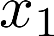
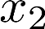
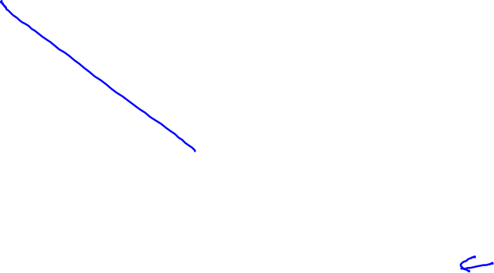
Supervised learning
Training set:

Slide 4
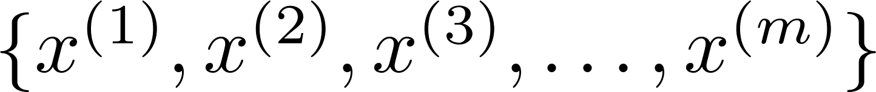
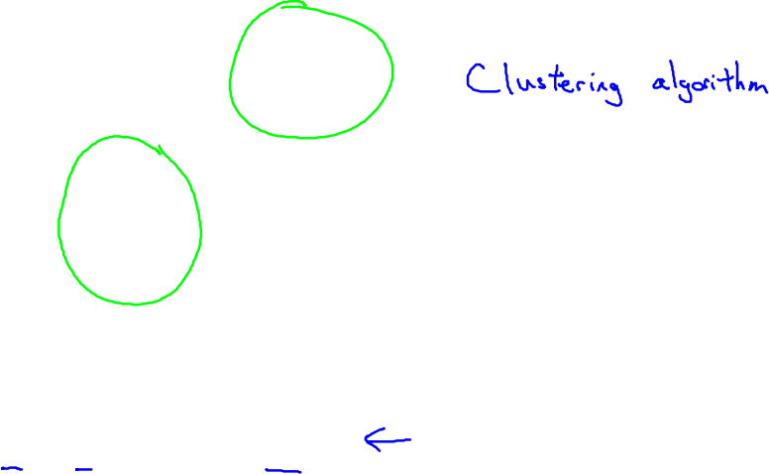
Unsupervised learning
Training set:

Slide 5
Applications of clustering

Slide 6


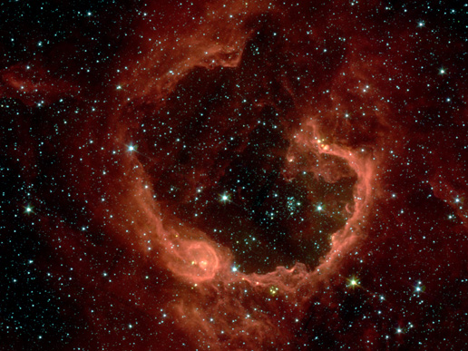
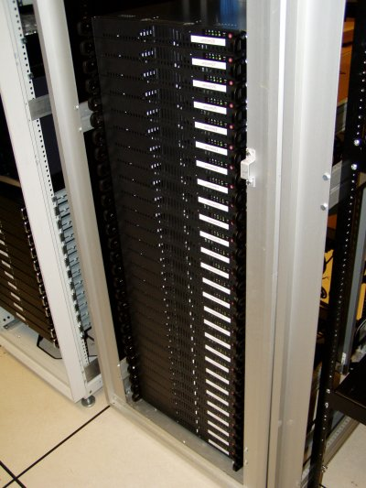
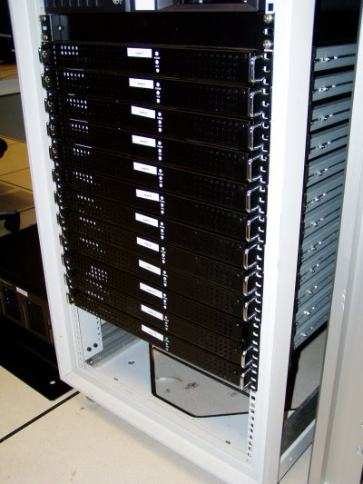
Applications of clustering
Market segmentation
Social network analysis
Image credit: NASA/JPL-Caltech/E. Churchwell (Univ. of Wisconsin, Madison)
Organize computing clusters
Astronomical data analysis
Notes:
Social network analysis e.g. try to detect communities/groupings based on social graphs
News, music e.g. try to cluster related news articles or songs
Market segmentation e.g. Try to cluster customers for targetted advertising

Slide 7
What is clustering?
Clustering is the classification of objects into different groups, or more precisely, the partitioning of a data set into subsets (clusters), so that the data in each subset (ideally) share some common trait - often according to some defined distance measure.

Slide 8
Types of clustering:
Hierarchical algorithms: these find successive clusters using previously established clusters.
1. Agglomerative ("bottom-up"): Agglomerative algorithms begin with each element as a separate cluster and merge them into successively larger clusters.
2. Divisive ("top-down"): Divisive algorithms begin with the whole set and proceed to divide it into successively smaller clusters.
2. Partitional clustering: Partitional algorithms determine all clusters at once. They include:
K-means and derivatives
Fuzzy c-means clustering

Slide 9
Introduction: Illustration
Illustrative Example: Agglomerative vs. Divisive
Agglomerative and divisive clustering on the data set {a, b, c, d ,e }
Step 0
Step 1
Step 2
Step 3
Step 4
Agglomerative
a
a b
b
a b c d e
c
c d e
d
d e
e
Divisive
Step 4
Step 3
Step 2
Step 1
Step 0

Slide 10
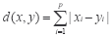
Common Distance measures:
Distance measure will determine how the similarity of two elements is calculated and it will influence the shape of the clusters.
They include:
1. The Euclidean distance (also called 2-norm distance) is given by:
2. The Manhattan distance (also called taxicab norm or 1-norm) is given by:

Slide 11
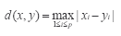
3.The maximum norm is given by:
4. The Mahalanobis distance corrects data for different scales and correlations in the variables.
5. Inner product space: The angle between two vectors can be used as a distance measure when clustering high dimensional data
6. Hamming distance (sometimes edit distance) measures the minimum number of substitutions required to change one member into another.

Slide 12
K-means Algorithm

Slide 13
K-MEANS CLUSTERING
The k-means algorithm is an algorithm to cluster n objects based on attributes into k partitions, where k < n.
Find the centers of natural clusters in the data.
K is positive integer number.
The grouping is done by minimizing the sum of squares of distances between data and the corresponding cluster centroid.
Notes:
Simply speaking k-means clustering is an algorithm to classify or to group the objects based on attributes/features into K number of group.

Slide 14
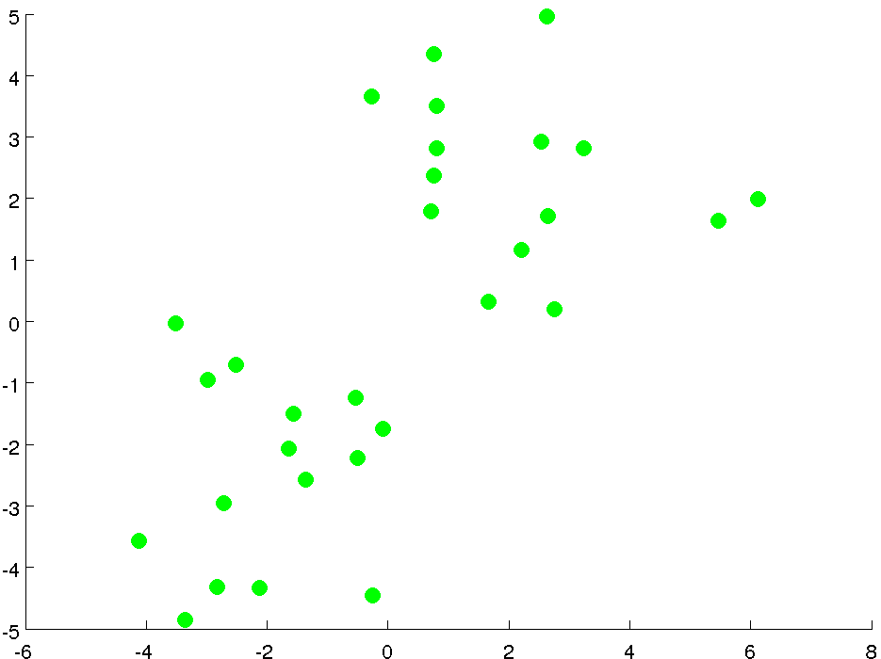

Slide 15
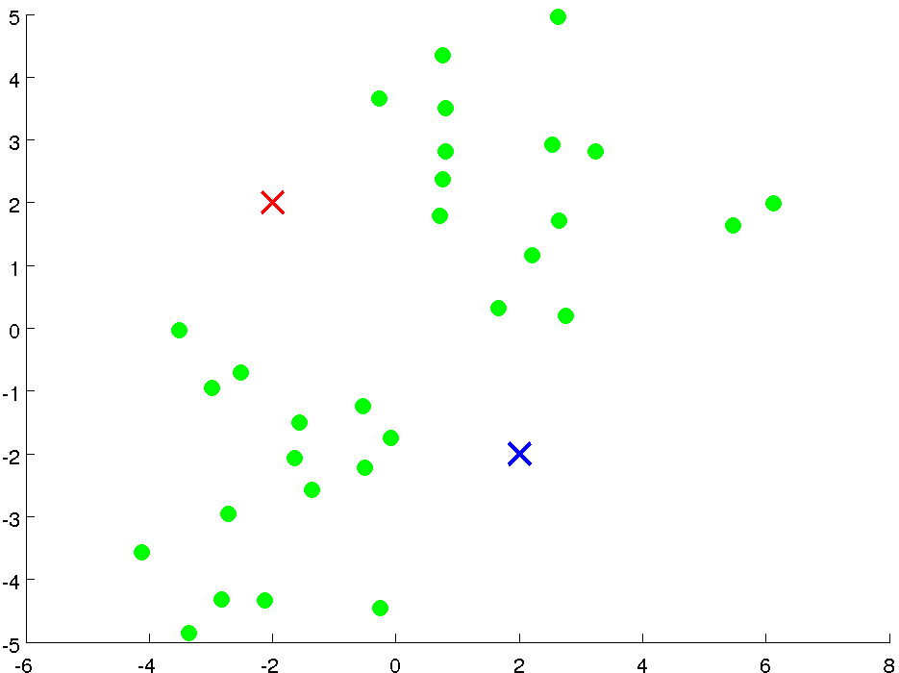

Slide 16
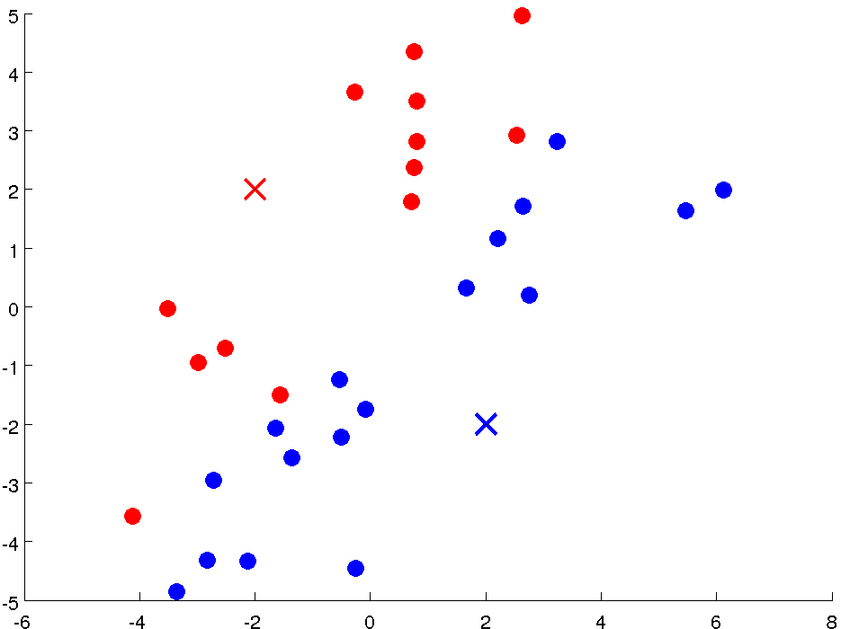

Slide 17
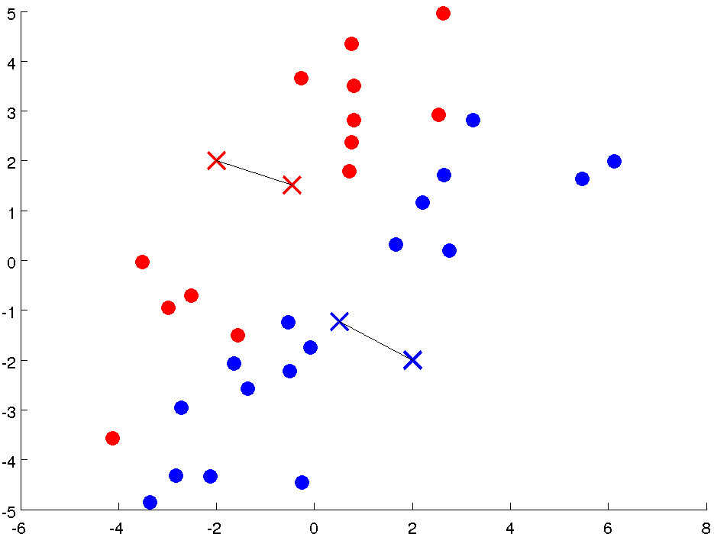
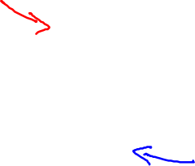

Slide 18
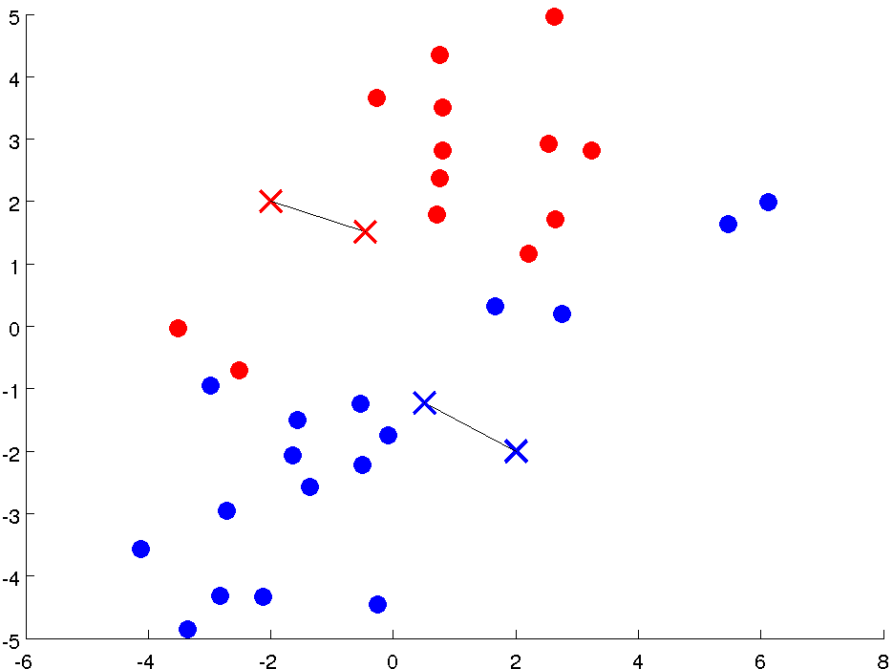

Slide 19
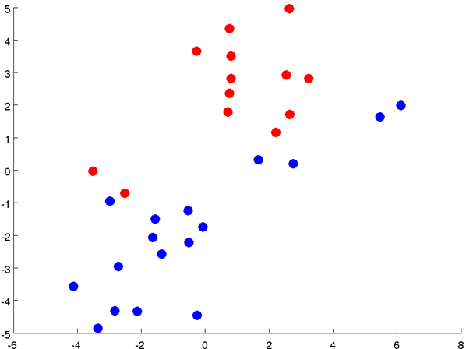

Slide 20
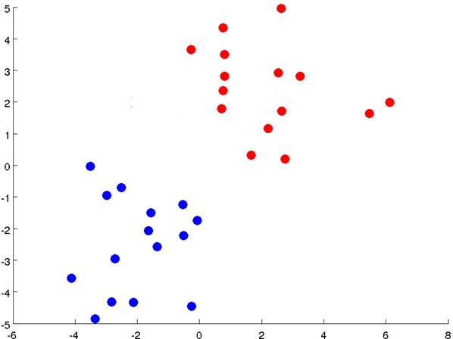

Slide 21
Notes:
Get rid of the legacy points

Slide 22
Notes:
Get rid of the legacy points

Slide 23
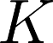
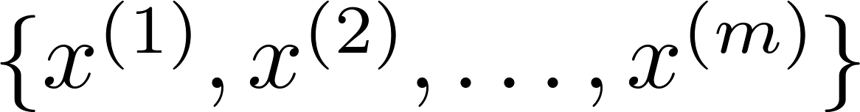
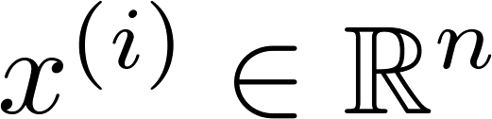
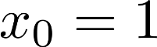
K-means algorithm
Input:
(number of clusters)
Training set
(drop convention)

Slide 24
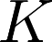
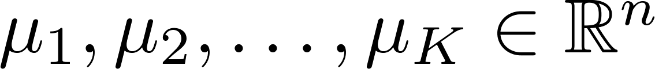
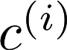
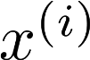
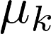
K-means algorithm
Randomly initialize cluster centroids
Repeat {
for = 1 to
:= index (from 1 to ) of cluster centroid
closest to
for = 1 to
:= average (mean) of points assigned to cluster
}

Slide 25
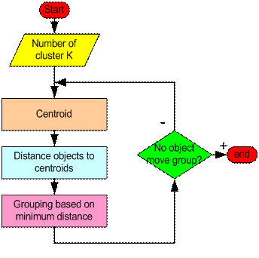
Flowchart of K-means algorithm
Notes:
https://www.statology.org/cluster-analysis-real-life-examples/

Slide 26
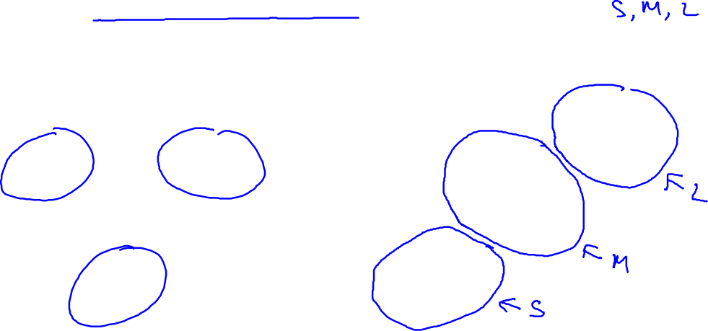
K-means for non-separated clusters
T-shirt sizing
Weight
Height

Slide 27
K-MEANS (Optimization Objective)

Slide 28
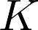
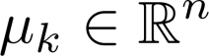
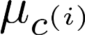
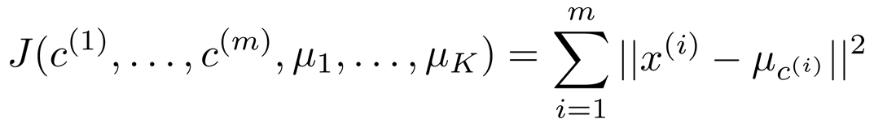
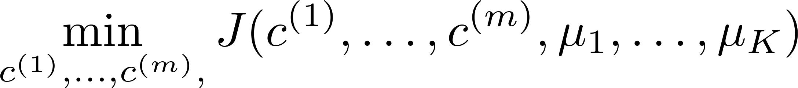
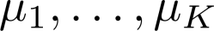
K-means optimization objective
= index of cluster (1,2,…, ) to which example is currently assigned
= cluster centroid ( )
= cluster centroid of cluster to which example has been assigned
Optimization objective:
Notes:
Within sum of squares

Slide 29
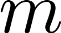
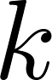
K-means algorithm
Randomly initialize cluster centroids
Repeat {
for = 1 to
:= index (from 1 to ) of cluster centroid
closest to
for = 1 to
:= average (mean) of points assigned to cluster
}
Notes:
Replace as previous; change spacing to fill page

Slide 30
K-MEANS (Random Initialization)

Slide 31
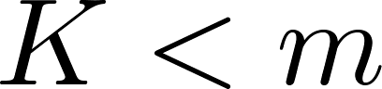
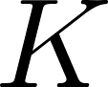
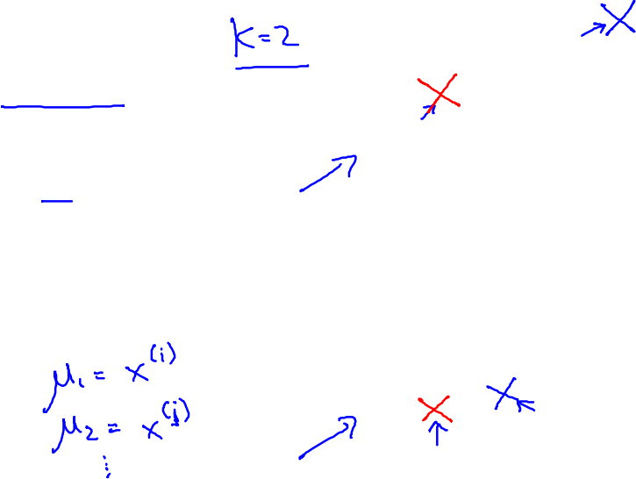
Random initialization
Should have
Randomly pick training
examples.
Set equal to these
examples.
Notes:
LATEX font

Slide 32
Local optima

Slide 33
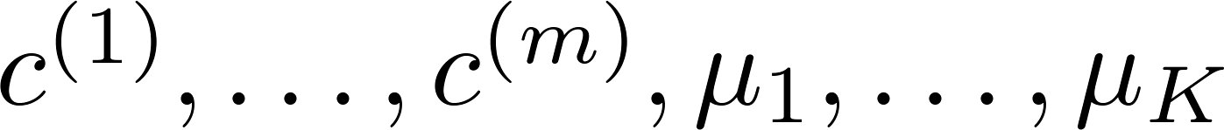
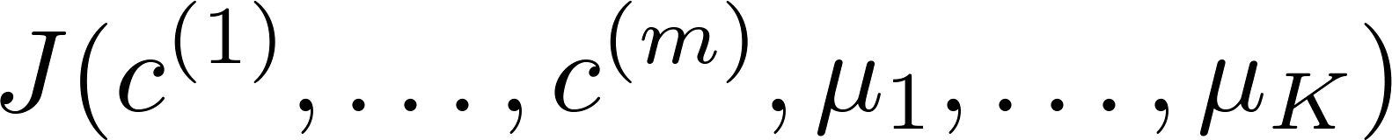
Random initialization
For i = 1 to 100 {
Randomly initialize K-means.
Run K-means. Get .
Compute cost function (distortion)
}
Pick clustering that gave lowest cost

Slide 34
Example of Implementation of k-Means when k=2

Slide 35
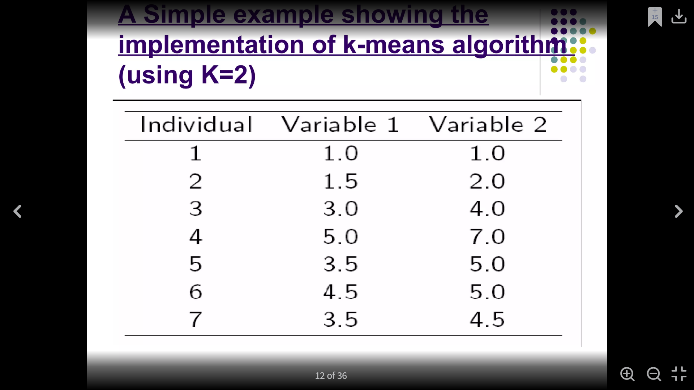
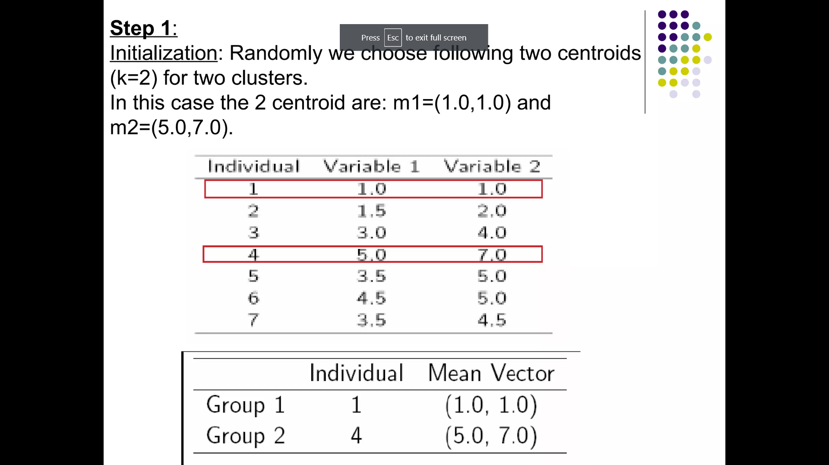
Step 1:
Initialization:
Randomly we choose following two centroids (k=2) for two clusters.
In this case the 2 centroid are: m1=(1.0,1.0) and m2=(5.0,7.0).

Slide 36
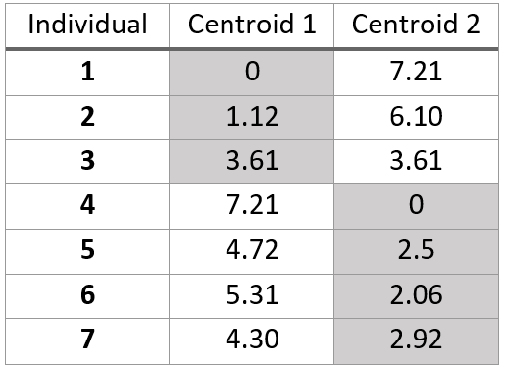
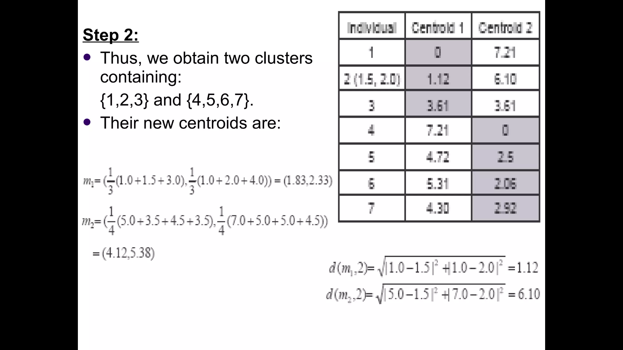
Step 2:
Thus, we obtain two clusters containing: {1,2,3} and {4,5,6,7}.
Their new centroids are:

Slide 37
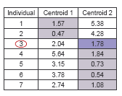
Step 3:
Now using these centroids, we compute the Euclidean distance of each object, as shown in the table.
Therefore, the new clusters are: {1,2} and {3,4,5,6,7}.
Next centroids are: m1=(1.25,1.5) and m2 = (3.9,5.1)

Slide 38
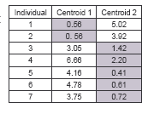
Step 4:
The clusters obtained are: {1,2} and {3,4,5,6,7}.
Therefore, there is no change in the cluster.
Thus, the algorithm comes to a halt here and the final result consists of 2 clusters {1,2} and {3,4,5,6,7}.

Slide 39
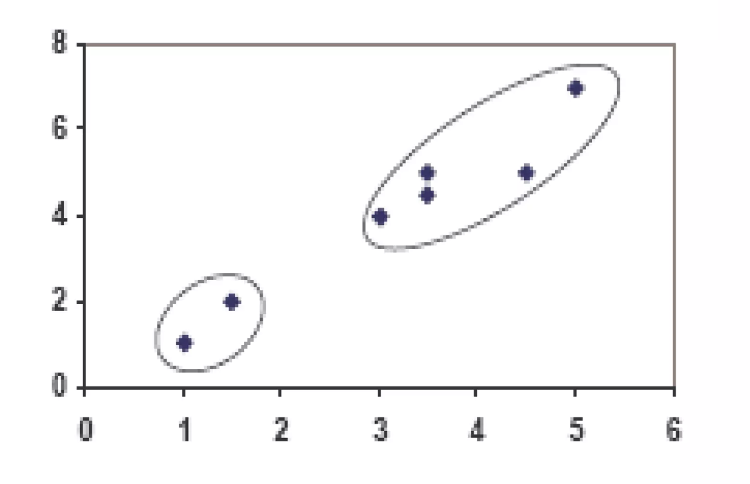
Plot

Slide 40
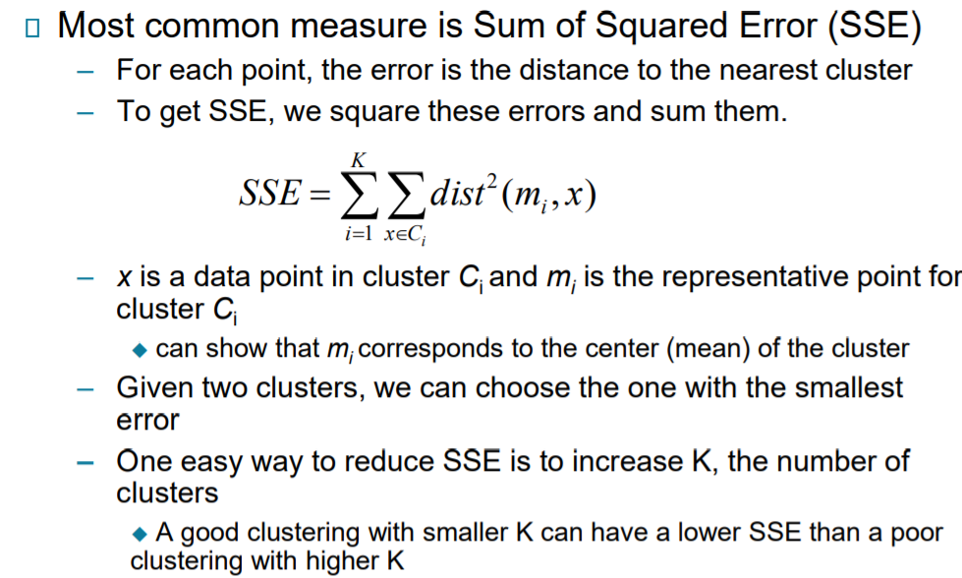
Evaluating K-Means Clusters
The quality of the cluster assignments is determined by computing the sum of the squared error (SSE) after the centroids converge

Slide 41
Choosing the number of clusters

Slide 42

What is the right value of K?

Slide 43


Choosing the value of K
Elbow method:
Elbow method gives us an idea on
what a good k number of clusters
would be based on the sum of squared
distance (SSE) between data points and
their assigned clusters’ centroids.
We pick k at the spot where SSE starts
to flatten out and forming an elbow
Cost function
(no. of clusters)
Notes:
take the elbow point value as the optimal value of K.
It should be either two, three, or at most four. But, beyond that, increasing the number of clusters does not dramatically change the value in WSS, it gets stabilized.

Slide 44

Choosing the value of K
Sometimes, you’re running K-means to get clusters to use for some later/downstream purpose. Evaluate K-means based on a metric for how well it performs for that later purpose.
E.g.
T-shirt sizing
T-shirt sizing
Weight
Weight
Height
Height

Slide 45


Strength and Weakness of K-Means Algorith
Strength
• Limitations

Slide 46

Limitations of K-means (Different Size)

Slide 47

Limitations of K-means (Different Density)

Slide 48

Limitations of K-means (Non Globular shape)

Slide 49
Weaknesses of K-Mean Clustering
When the numbers of data are not so many, initial grouping will determine the cluster significantly.
The number of cluster, K, must be determined before hand. Its disadvantage is that it does not yield the same result with each run, since the resulting clusters depend on the initial random assignments.
We never know the real cluster, using the same data, because if it is inputted in a different order it may produce different cluster if the number of data is few.
It is sensitive to initial condition. Different initial condition may produce different result of cluster. The algorithm may be trapped in the local optimum.

Slide 50
CONCLUSION
K-means algorithm is useful for undirected knowledge discovery and is relatively simple. K-means has found wide spread usage in lot of fields, ranging from unsupervised learning of neural network, Pattern recognitions, Classification analysis, Artificial intelligence, image processing, machine vision, and many others.

Slide 51

Class Activity
Q1. Implement k-means algorithm on the data given in Figure 1. The value of k is 3. Use Euclidean distance as the distance measure. (20)
Figure 1

Slide 52

When k=3

Slide 53

Plot when k=3
For more examples : https://codinginfinite.com/k-means-clustering-explained-with-numerical-example/

Slide 54
K-Means++
K-Means++ is an enhanced version of the traditional K-Means clustering algorithm, designed to improve the quality of clustering results by addressing the issue of initial centroid selection.
In K-Means++, the initial centroids are chosen in a more intelligent manner compared to random initialization in K-Means.
The algorithm starts by selecting the first centroid randomly from the data points.
Subsequent centroids are selected iteratively based on a probability distribution that favors points that are farther away from already chosen centroids.
This process ensures that centroids are well spread out across the dataset.

Slide 55
Initialization algorithm:
Randomly select the first centroid from the data points.
For each data point compute its distance from the nearest, previously chosen centroid.
Select the next centroid from the data points such that the probability of choosing a point as centroid is directly proportional to its distance from the nearest, previously chosen centroid. (i.e. the point having maximum distance from the nearest centroid is most likely to be selected next as a centroid)
Repeat steps 2 and 3 until k centroids have been sampled
Notes:
By following the above procedure for initialization, we pick up centroids that are far away from one another.

Slide 56


Notes:
https://www.geeksforgeeks.org/ml-k-means-algorithm/

Slide 57
Class Activity
Q1. Implement k-means++ algorithm on the data given in Figure 1. The value of k is 3. Use Euclidean distance as the distance measure. Assume initial centroid as (1,1).
Figure 1

Slide 58
K-mediods Clustering
Always data points are selected as mediods
• Less sensitive to outliers
• For K-Means, we were working with centroids.
• The relationship between centroids and medoids is similar to the relationship between means and medians.
Medoids and medians will always be one of the observations in the data, while that’s not necessarily the case for centroids and means.

Slide 59
How to find Mediods:
For odd sum:
[(1, 5), (3, 8), (4, 9), (6, 10), (9, 12)]
X = 1, 3, 4, 6. 9
Sum is 5 (odd)
Y = 5, 8, 9, 10, 12
Mediods = Median of each attribute = (4, 9)
For even sum:
X = 2, 4, 5, 7, 9, 10
Y = 3, 4, 6, 8, 12, 14
Sum = 6 (even)
Mediods = mean of center two elements = (6, 7)
X = (5+7)/2 = 6
Y = (6+8)/2 = 7

Slide 60
CLUSTER ANALYSIS
Partitioning Methods: k-means & k-medoids
The mean or median can be used as a model for its cluster
A new example can be assigned to the cluster on the basis of smallest distance between the cluster mean (median) and the example
Thus the data space is partitioned into k regions
A medoid can be defined as the object of a cluster whose average dissimilarity to all the objects in the cluster is minimal, that is, it is a most centrally located point in the cluster.

Slide 61

K-Mediod (Partioning Around the medoids)

Slide 62


Slide 63


Slide 64


Slide 65


Slide 66



Slide 67
Q1. Implement K-Medoids Algorithm on the data given in Figure 1.
The value of k is 2. (20)
Figure 1

